Slide 1

The Scramble for Africa
© Student Handouts, Inc. www.studenthandouts.com

Slide 2


THE “DARK” CONTINENT
“Dark Continent” – racist terminology referred to both the peoples of Africa and their alleged ignorance
In reality, Africa has always had diverse groups of people with their own unique cultures and histories
Civilizations
Languages
Religions
Notes:
Possible anecdote: Review of African cultures and civilizations, such as Mansa Musa and Great Zimbabwe.

Slide 3

GEOGRAPHY OF AFRICA
Continent – not a country
Continent is three times larger than Europe
Northern Africa – desert
Mid-to-southern Africa – diverse climates and topography

Slide 4
FOREIGN HISTORY IN AFRICA
Greeks controlled Egypt after conquest by Alexander the Great
Ptolemaic dynasty
Romans ruled all areas along the Mediterranean coastline, including northern Africa
Mediterranean – “Roman lake”
Arab traders converted many Africans to Islam from the 7th century
Source of slaves for the Americas from the 17th century
But little foreign interest in the interior of sub-Saharan Africa

Slide 5
The “OPENING UP” OF AFRICA
Mid-1800s
Missionaries and explorers sparked foreign interest in Africa

Slide 6
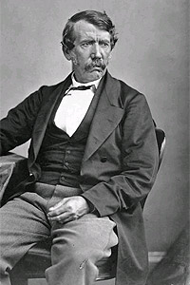
DAVID LIVINGSTONE (1813-1873)
Scottish missionary
1841-1873 – lived in central Africa
Explored Africa
Named Lake Victoria after the British queen
Converted many Africans to Christianity
Wrote books on Africa which piqued foreign interest
1871 – reported “lost”
“Found” by Henry Stanley
“Dr. Livingstone, I presume?”

Slide 7
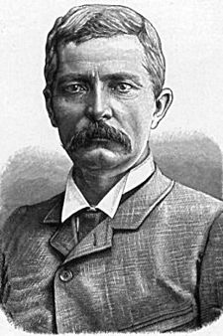
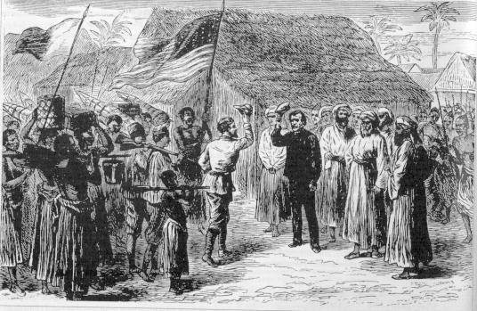
HENRY STANLEY (1841-1904)
Welsh-American reporter
“Found” Dr. Livingstone in Africa
“Dr. Livingstone, I presume?”
Explored Africa
Congo River
Lake Tanganyika
Lake Victoria
Worked with Belgium’s King Leopold II and his African colonization company
International African Society

Slide 8
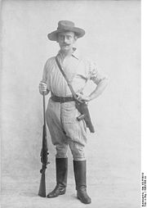
KARL PETERS (1856-1918)
German explorer in Africa
Organized and propagandized for Germany’s colonial expansion
Founded the Society for German Colonization
Acquired German East Africa (modern-day Tanzania)
Convinced Otto von Bismarck to take over German East Africa and increase Germany’s colonies in Africa

Slide 9
CECIL RHODES (1853-1902)
British businessman and politician in southern Africa
Made a fortune from African diamond mines
Established South African Company
Land later became Rhodesia (Zimbabwe)
Prime minister of Cape Colony (1890-1896)
Wanted British control over South Africa
Wanted Cape-to-Cairo Railroad
Architect of British imperialism in southern Africa
Great Britain became leading colonial power in southern Africa

Slide 10
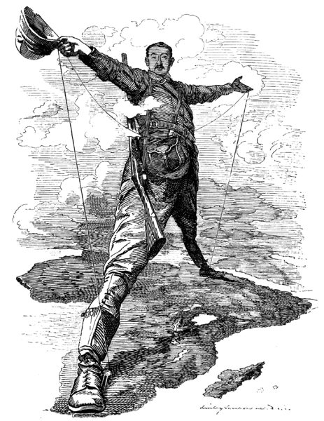
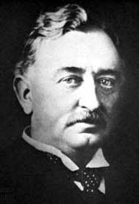
CECIL RHODES (1853-1902)

Slide 11
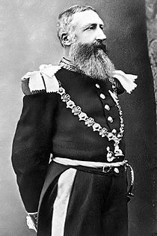
KING LEOPOLD II OF BELGIUM (1835-1909)
Took over land in central Africa
Berlin Conference (1885)
Leopold’s control over Congo Free State recognized by major powers
Belgian Congo (1908)
Leopold criticized for the cruelty of his rule in the Congo
Leopold forced to sell Congo Free State to Belgian government
Renamed Belgian Congo
Created European race for African colonies – “Scramble for Africa”
Diamonds, foodstuffs, gold, ivory, rubber

Slide 12
BRITISH IN SOUTHERN AFRICA
1815 – British took Cape Colony from the Dutch
Boers moved north
Transvaal
1886 – gold discovered and British moved in
1881 and 1895 – British attempted to take Transvaal from the Boers
Orange Free State
Boer War (1899-1892)
Dutch led by President Paul Kruger
British won

Slide 13
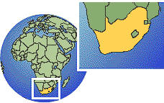
UNION OF SOUTH AFRICA
Created in 1910
Included Cape Colony, Orange Free State, Natal, and Transvaal
Self-government

Slide 14
BRITISH COLONIES IN SOUTHERN AFRICA
Rhodesia (now Zimbabwe)
Named for Cecil Rhodes
North of Union of South Africa
Bechuanaland (now Botswana)
1885 – became a British protectorate
Kenya
1888 – became a British protectorate

Slide 15
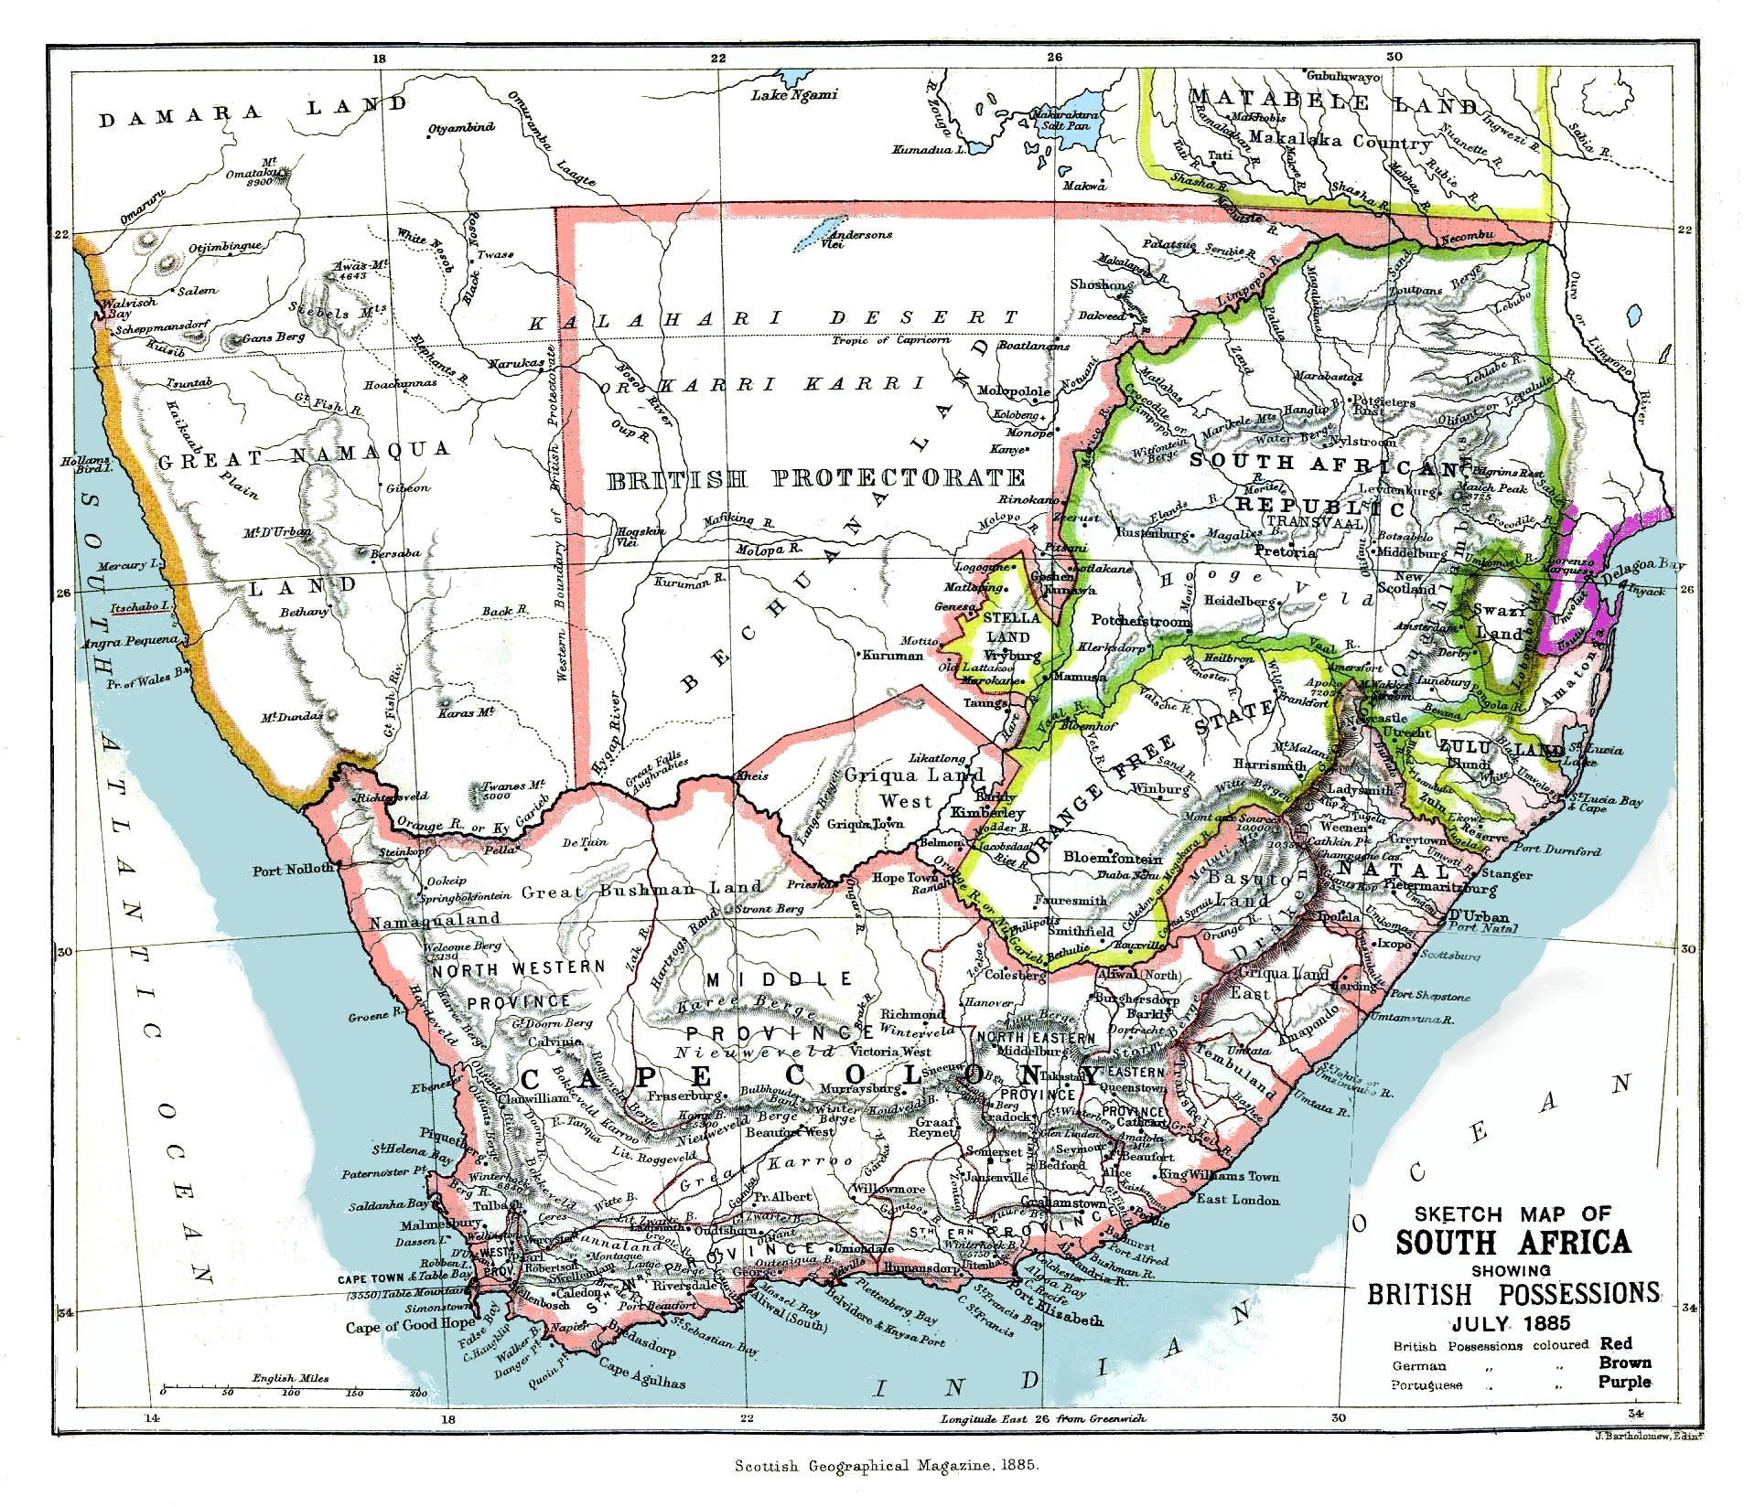

Slide 16
BRITISH IN NORTH AFRICA
Egypt – in name ruled by Ottoman Turks, but largely independent
European capital investments
Suez Canal opened in 1869
Built by the Egyptians and French
Taken over by the British (1875)
British Prime Minister Benjamin Disraeli
Bought shares in Suez Canal Company from Egypt
Egypt was nearly bankrupt from the expense of building the Suez Canal
British government became largest shareholder

Slide 17
EUROPEANS IN EGYPT
1870s – with the Egyptian government bankrupt, the British and French took over financial control of the country
Egyptian monarchs (technically Ottoman viceroys) ruled as puppet leaders
1882 – Egyptian nationalist rebellion
France withdrew its troops
Great Britain left in control of Egypt
Lord Cromer introduced reforms
De facto British protectorate
Made official in 1914
Independence came in 1922

Slide 18
BRITISH IN NORTHERN AFRICA
Sudan
Area south of Egypt
Under Anglo-Egyptian control
Cotton needed for British textile mills
Entente Cordiale (1904)
Great Britain controlled Sudan
France controlled Morocco
Cape-to-Cairo Railroad
Idea of Cecil Rhodes
Would secure Great Britain’s dominance in Africa
Never completed – sections missing through modern Sudan and Uganda

Slide 19
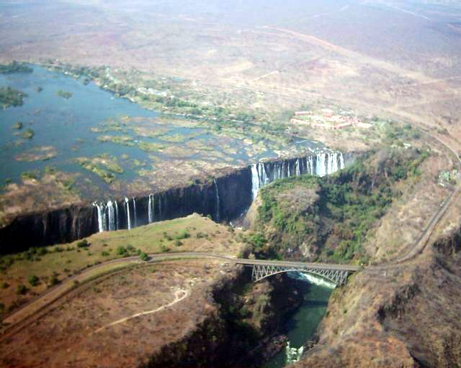
Cape-to-Cairo Railway: Crossing over Victoria Falls

Slide 20
FRENCH IN AFRICA
Algeria
1830 – invasion
1831 – annexation
Tunis
1881 – controlled by France
Led Italy to join the Triple Alliance with Austria-Hungary and Germany
Morocco
1881 – large part under French control
1905 and 1911 – nearly sparked a European war between France and Germany
1906 – Algeciras Conference – Germany recognized French rights in Morocco
1911 – Agadir Crisis – Germany recognized French protectorate over Morocco in exchange for part of France’s territory in the Congo

Slide 21
FRENCH IN AFRICA
Madagascar
1896 – controlled by France
Somaliland
1880s – partly under French control
West Africa
Late 1800s – largely under French control
Sudan
1898 – met Britain’s area of control and nearly went to war
Entente Cordiale settled British-French disputes in Africa

Slide 22

FRENCH IN AFRICA
By World War I – 1914
France controlled 3,250,000 square miles in Africa
14 times the area of France
France ruled 30,000,000 Africans
75% of the population of France

Slide 23
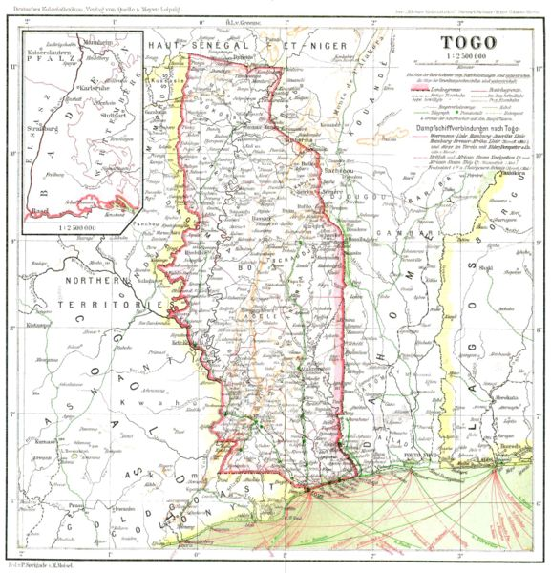
GERMANS IN AFRICA
Togoland (now Togo and Ghana)
Cameroons (now Cameroon and Nigeria)
Southwest Africa (now Namibia)
East Africa (now Burundi, Rwanda, and Tanzania)

Slide 24
ITALIANS IN AFRICA
1882-1896
Eritrea (along the Red Sea)
Somaliland (along the Indian Ocean, part of today’s Somalia)
1896
Defeated in attempt to conquer Abyssinia (Ethiopia)
1912
Won Tripoli from Ottoman Turks

Slide 25
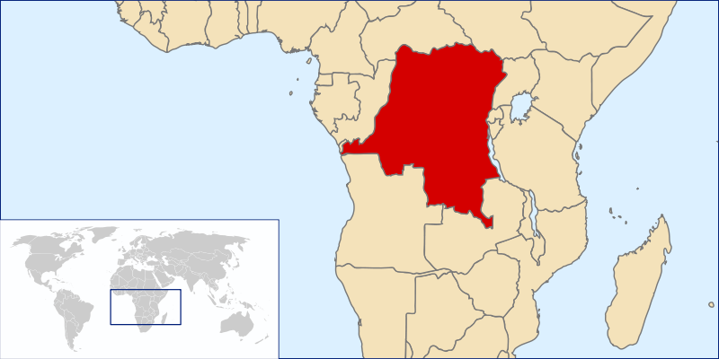
BELGIANS IN AFRICA
1908
Belgium gained control of Congo (Congo Free State) from King Leopold II
Leopold was infamous for the cruelty of his rule in the Congo
Congo Free State (today’s Democratic Republic of Congo)
80 times the size of Belgium
Source of uranium

Slide 26
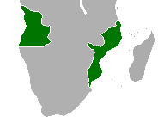
PORTUGUESE IN AFRICA
Under “old imperialism” Portugal gained African territory and led the early trans-Atlantic African slave trade
Angola
Mozambique
Portuguese territory in Africa, 1810

Slide 27
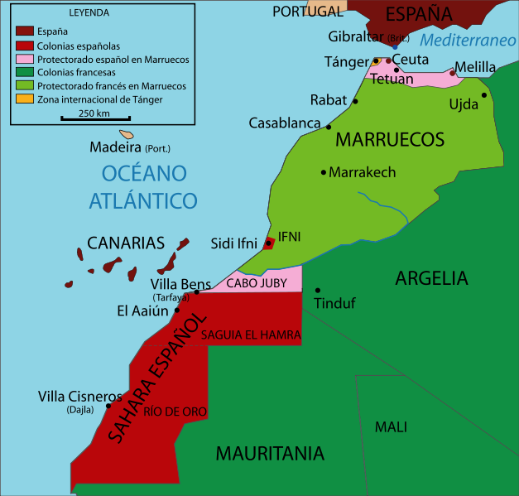
SPANISH IN AFRICA
Spain had very few possessions in Africa
Tip of Morocco
Rio de Oro
Rio Muni

Slide 28
AFRICANS IN AFRICA
By the time of the First World War (1914)
Only 2 independent African countries
Abyssinia (Ethiopia)
Ruled by dynasty stretching back to at least the 13th century
Last emperor was Haile Selassie, deposed in 1974
Home to Ethiopian Orthodox Christian Church (strongly tied to Egyptian Coptic Church)
Liberia
Formed by freed slaves under auspices of the United States government

Slide 29
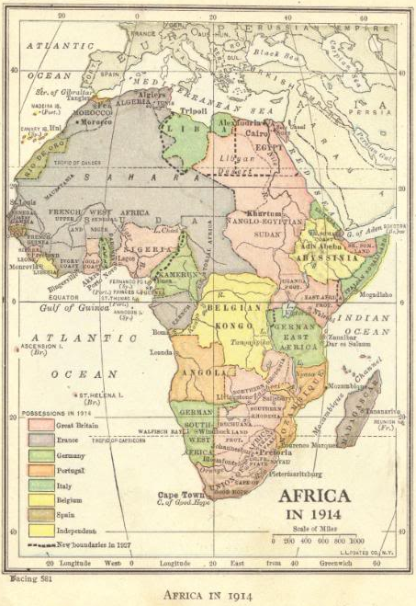

Slide 30
REVIEW QUESTIONS
What led to the “Scramble for Africa”?
Which European nations controlled the most land in Africa?
Who led British imperialism in Africa?
Which African nations were left independent at the time of World War I?

